Slide 1
Table 1. Summarize the variables of Data Set
Variable Name | Min | 1st.Q | Median | 3rd.Q | Max | Mean | SD
Fixed.acidity | 3.80 | 6.30 | 6.80 | 7.30 | 14.20 | 6.86 | 0.844
Volatile.acidity | 0.08 | 0.21 | .026 | 0.32 | 1.10 | 0.28 | 0.101
Citric.acid | 0.00 | 0.27 | 0.32 | 0.39 | 1.66 | 0.33 | 0.121
Residual.sugar | 0.60 | 1.70 | 5.20 | 9.90 | 65.80 | 6.29 | 5.072
Chlorides | 0.01 | 0.04 | 0.04 | 0.050 | 0.35 | 0.05 | 0.022
Free.sulfur.dioxide | 2.00 | 23.00 | 34.00 | 46.00 | 289.00 | 35.31 | 17.01
Total.sulfur.dioxide | 9.00 | 108.00 | 134.00 | 167.00 | 440.00 | 138.40 | 42.50
Density | 0.99 | 0.99 | 0.99 | 1.00 | 1.04 | 0.99 | 0.003
PH | 2.72 | 3.09 | 3.18 | 3.28 | 3.82 | 3.19 | 0.151
Sulphates | 0.22 | 0.41 | 0.47 | 0.55 | 1.08 | 0.49 | 0.114
Alcohol | 8.00 | 9.50 | 10.40 | 11.40 | 14.20 | 10.51 | 1.231

Slide 2
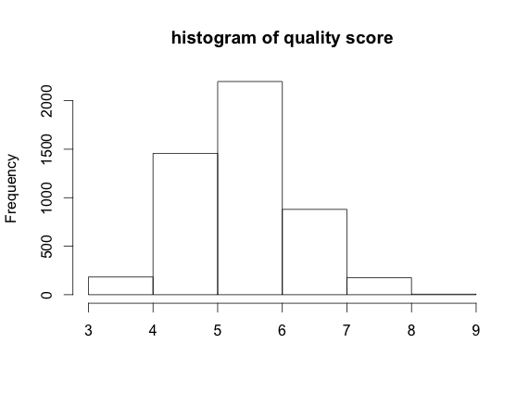
Table 2. Quantity of wines by quality of scores.
Scores | 3 | 4 | 5 | 6 | 7 | 8 | 9
Quantity | 20 | 163 | 1457 | 2198 | 880 | 175 | 5

Slide 3
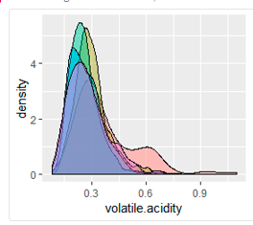
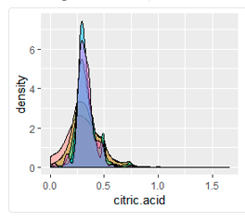
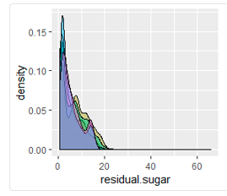
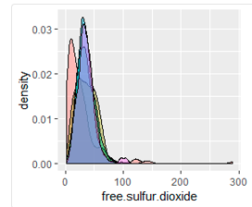
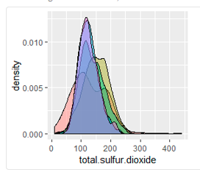
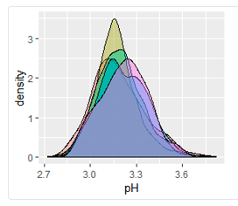
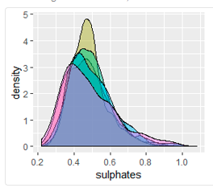
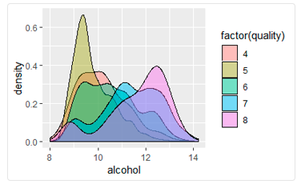
Figure 1. Density plots of variable by scores of quality

Slide 4
Tabel 3. means of different variable by score of wine quality
variables | 4 | 5 | 6 | 7 | 8
fixed.acidity | 7.18 | 6.93 | 6.83 | 6.73 | 6.67
volatile.acidity | 0.37 | 0.30 | 0.26 | 0.26 | 0.27
citric.acid | 0.30 | 0.33 | 0.33 | 0.32 | 0.32
residual.sugar | 4.82 | 7.33 | 6.44 | 5.18 | 5.62
chlorides | 0.05 | 0.05 | 0.04 | 0.03 | 0.03
free.sulfur.dioxide | 26.63 | 36.43 | 35.65 | 34.12 | 36.62
total.sulfur.dioxide | 130.23 | 150.90 | 137.04 | 125.1 | 125.88
density | 0.99 | 0.99 | 0.99 | 0.99 | 0.99
pH | 3.18 | 3.16 | 3.18 | 3.21 | 3.21
sulphates | 0.47 | 0.48 | 0.49 | 0.50 | 0.48
alcohol | 10.17 | 9.80 | 10.57 | 11.36 | 11.65

Slide 5
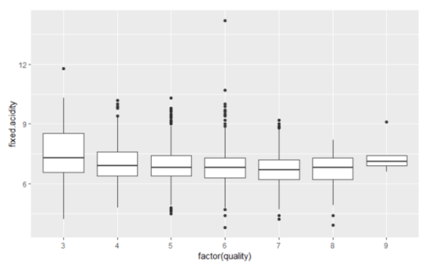
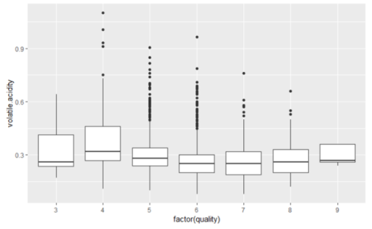
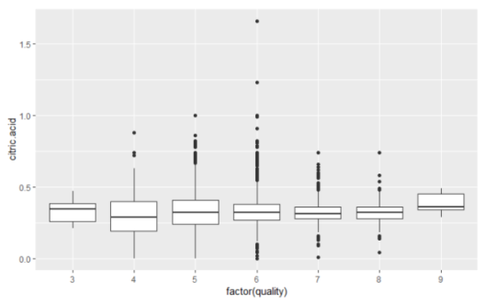
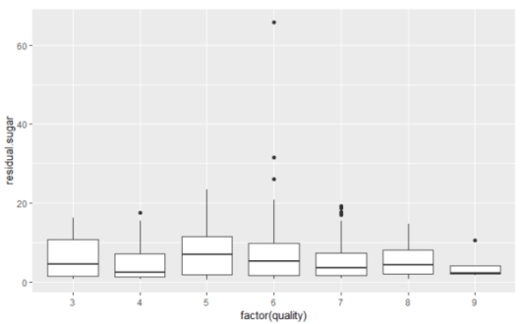
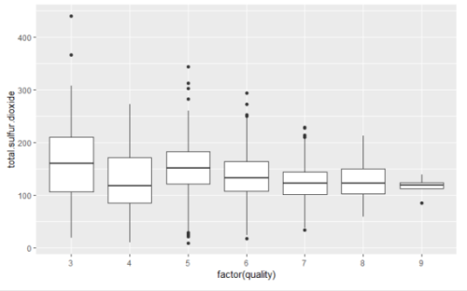
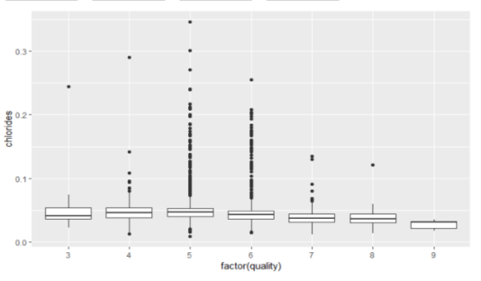
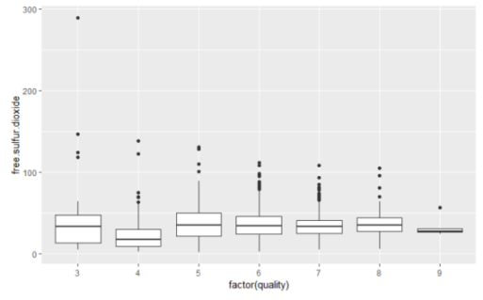
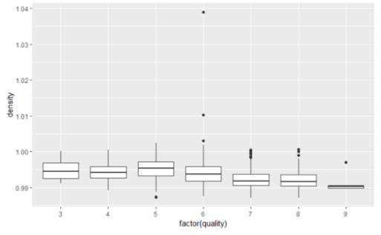
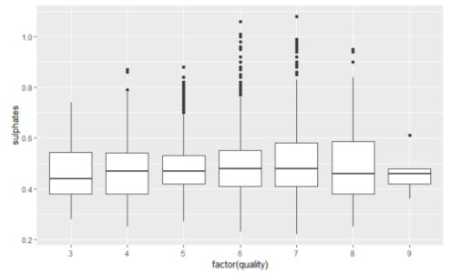
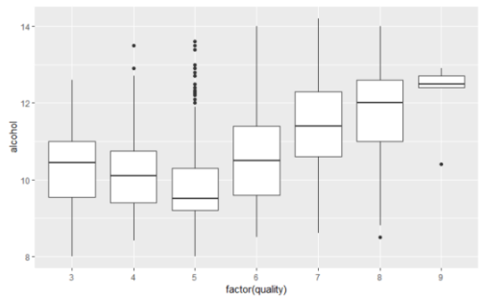
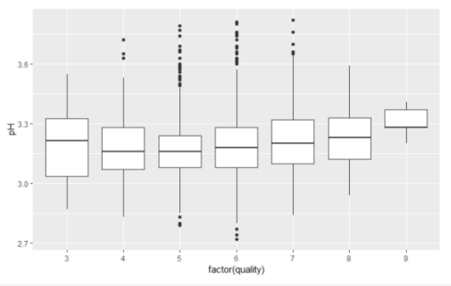
Figure 2. Boxplot of variables by score of quality

Slide 6
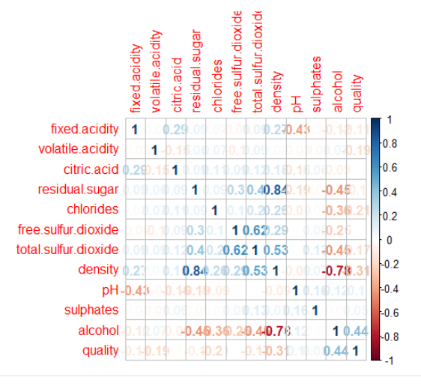
Figure 3. Correlations between variables

Slide 7
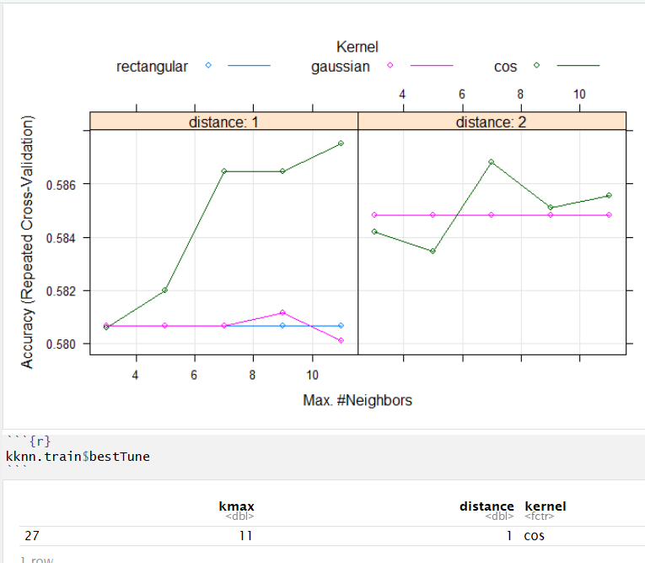
Figure 4. knn full model

Slide 8
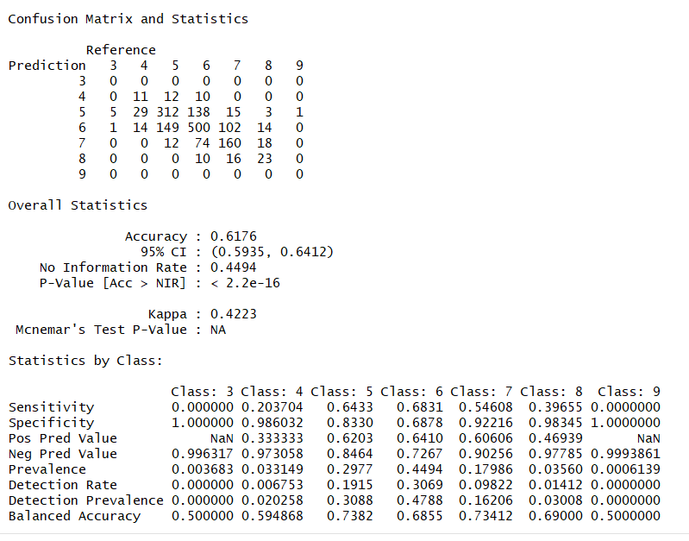
Figure 5. Confusion matrix and statistics of k-NN full model

Slide 9
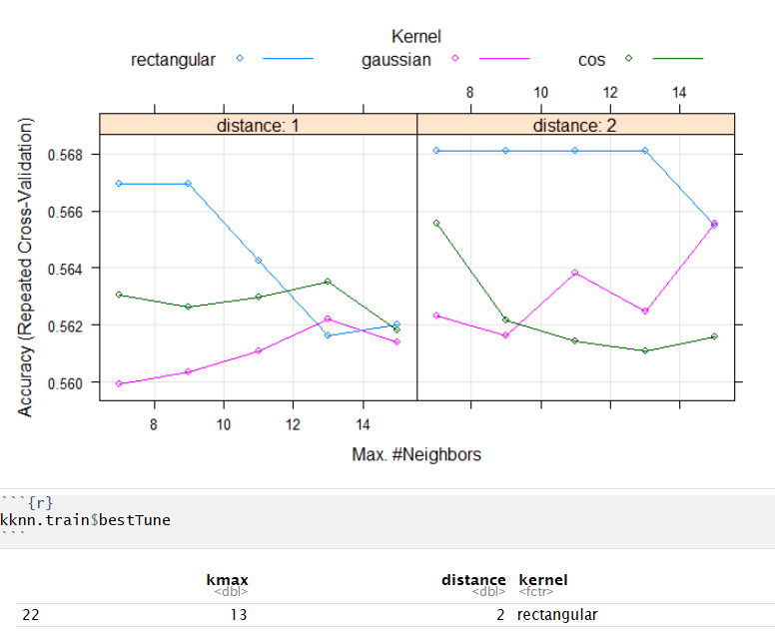
Figure 6. knn reduced model

Slide 10
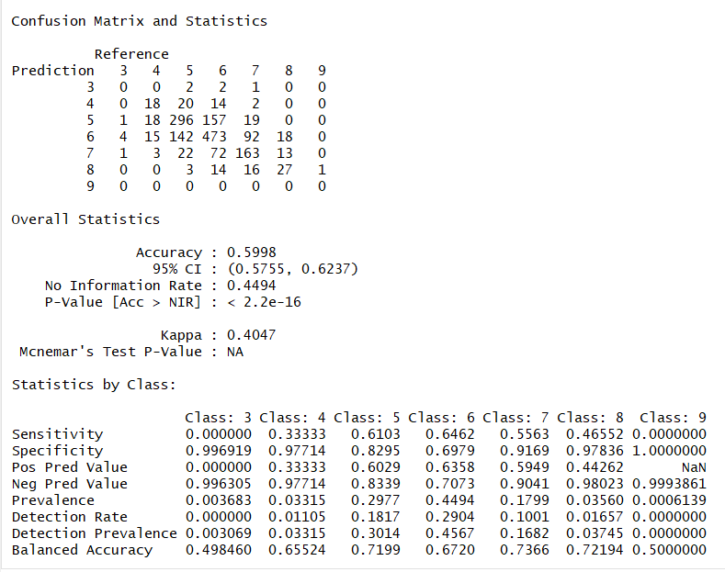
Figure 7. Confusion matrix and statistics of k-NN reduced model

Slide 11
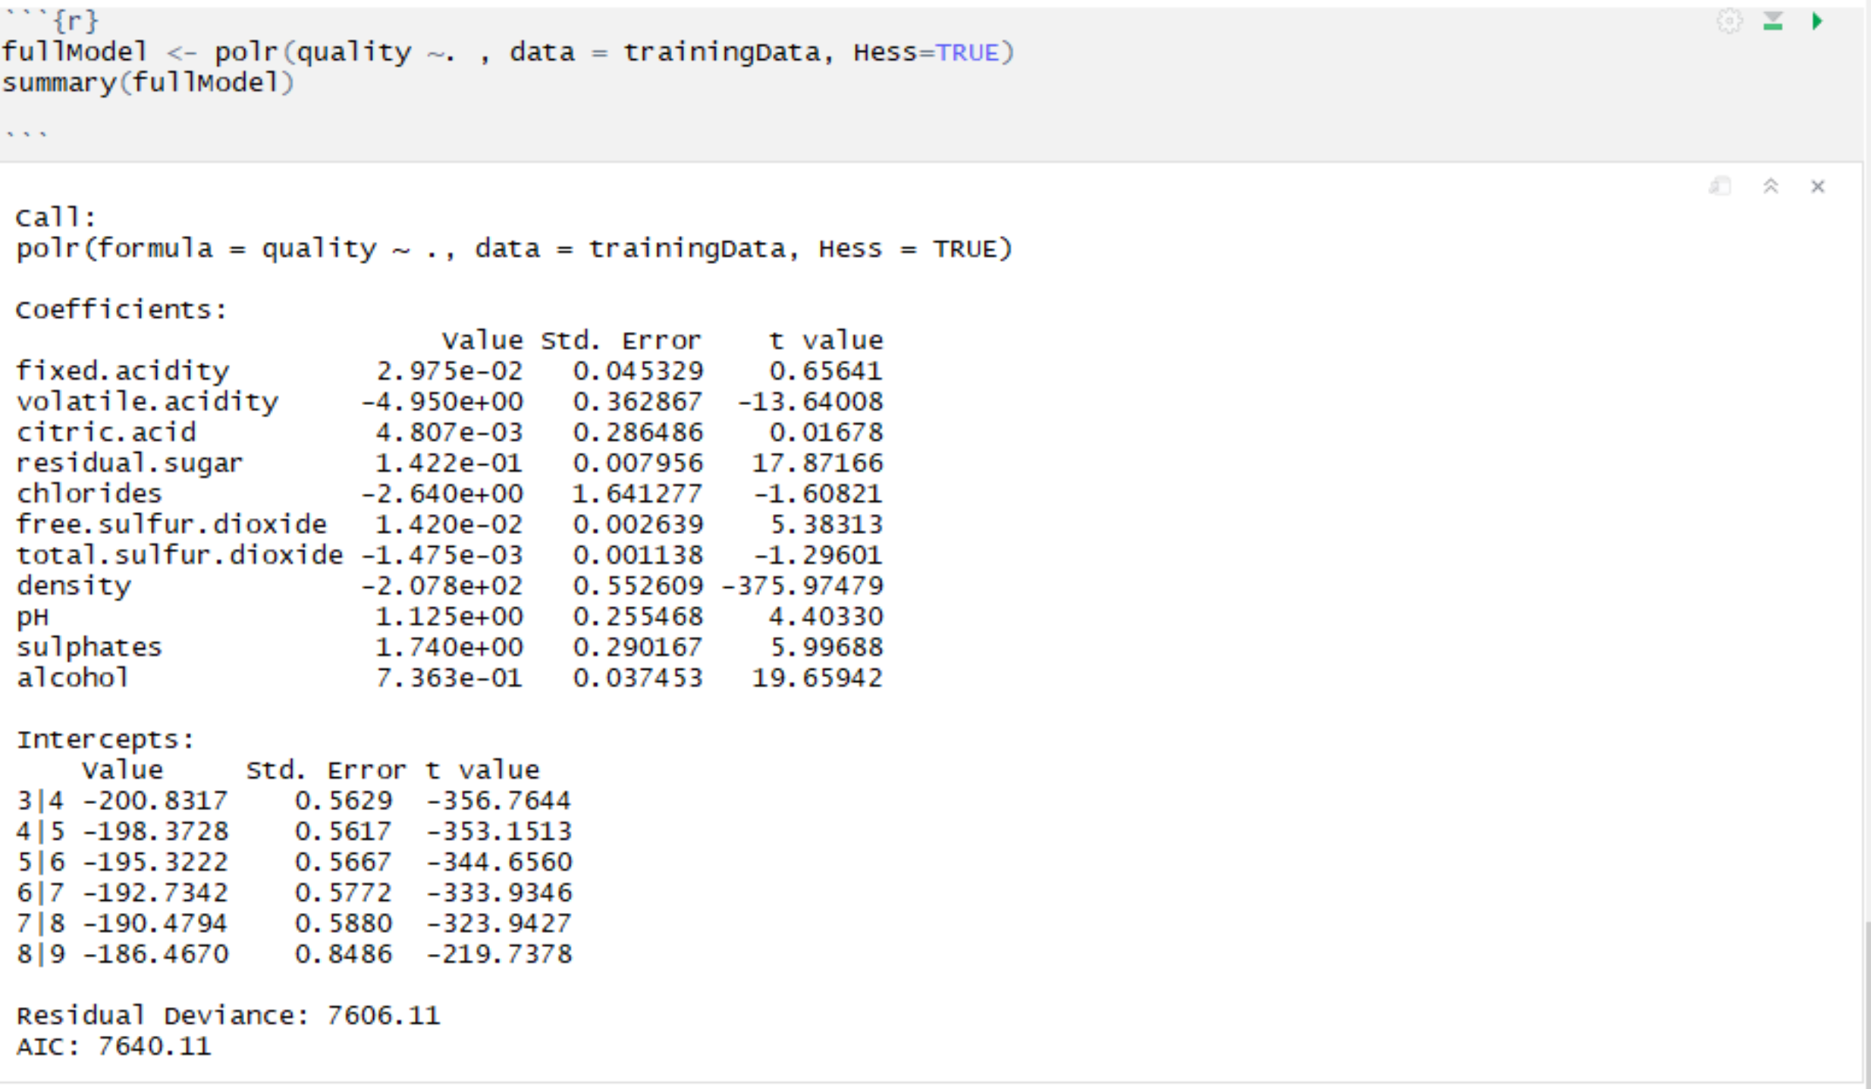
Full Model

Slide 12
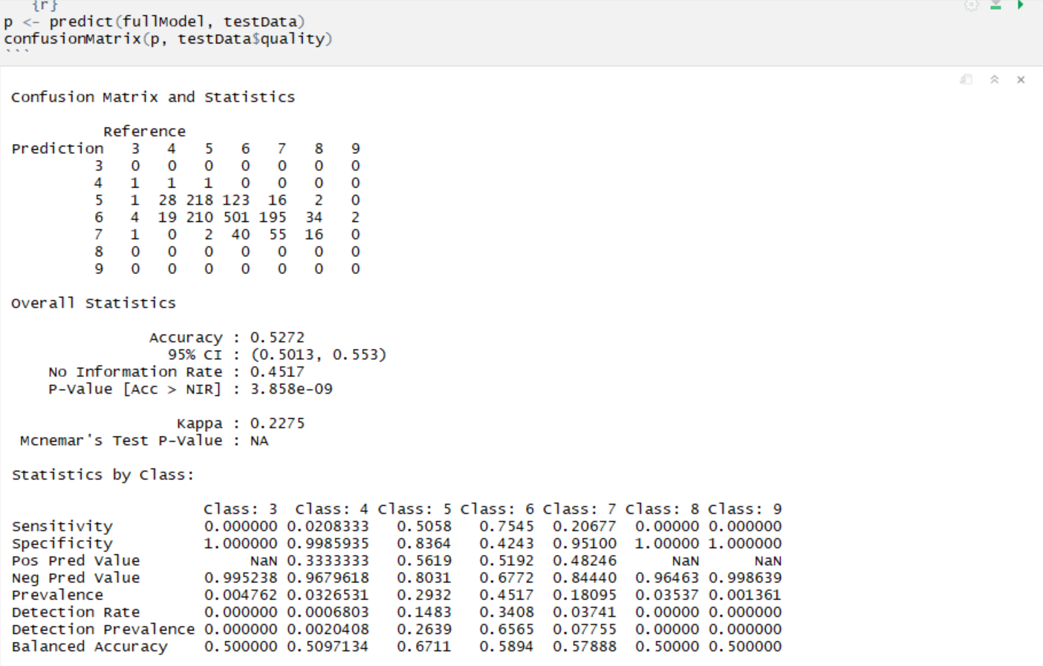

Slide 13
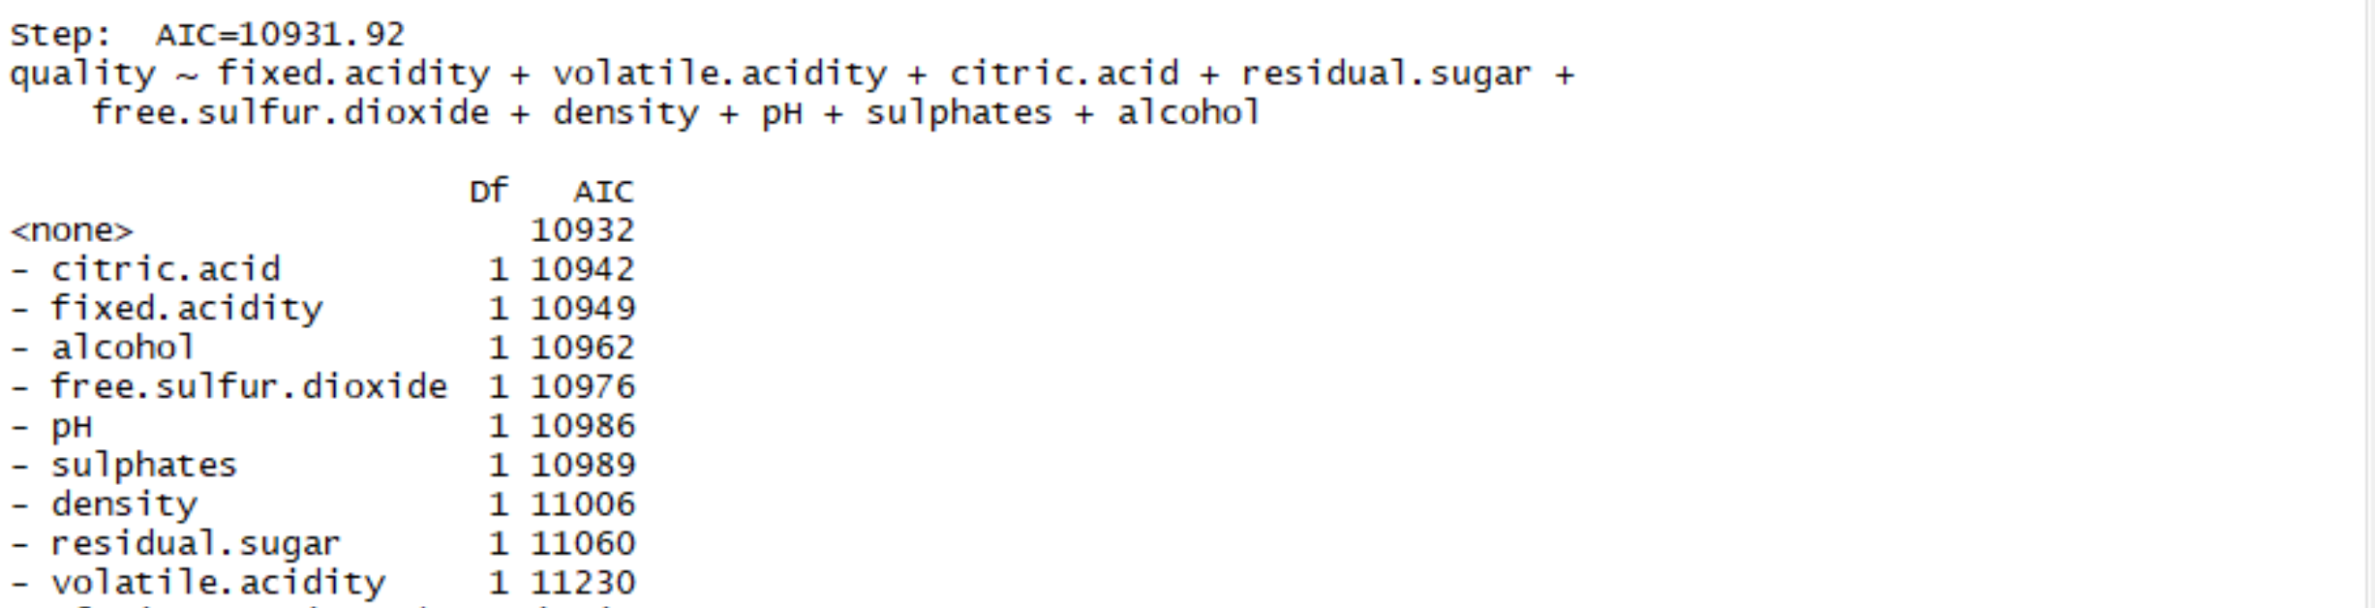
Step()

Slide 14

Step confusion matrix

